Slide 1
Rubik’s Cube Visualization in R
黃敬麟 Ching-Lin Huang
B05201010
Forth year in Department of Mathematics, National Taiwan University
Github: https://github.com/Katasuke/RubiksCube

Slide 2
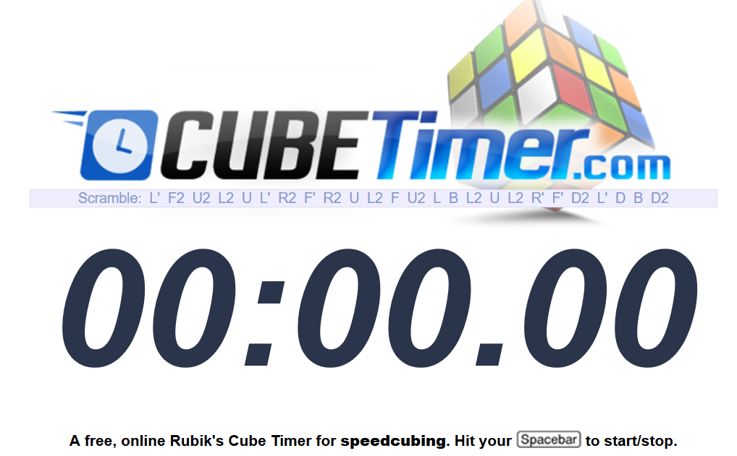
Introduction
Visualization
Simulation: using standard notation of Rubik’s cube
Shiny application

Slide 3
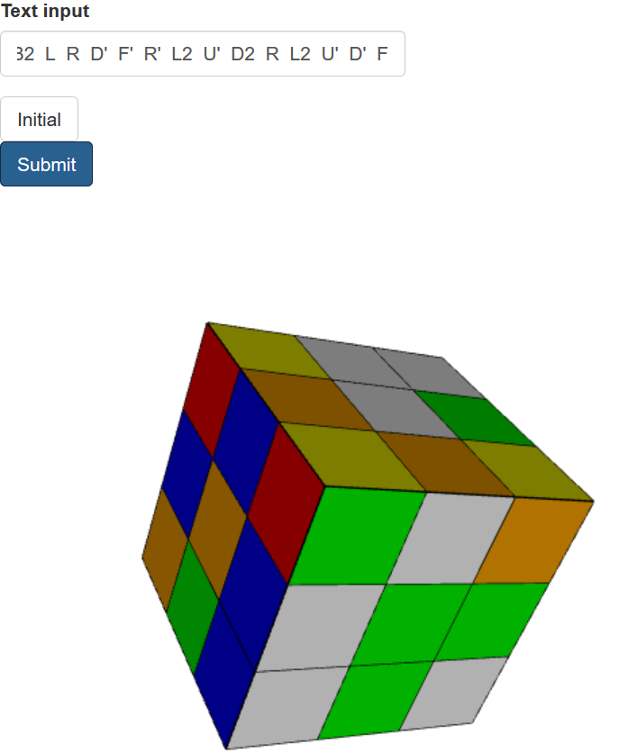
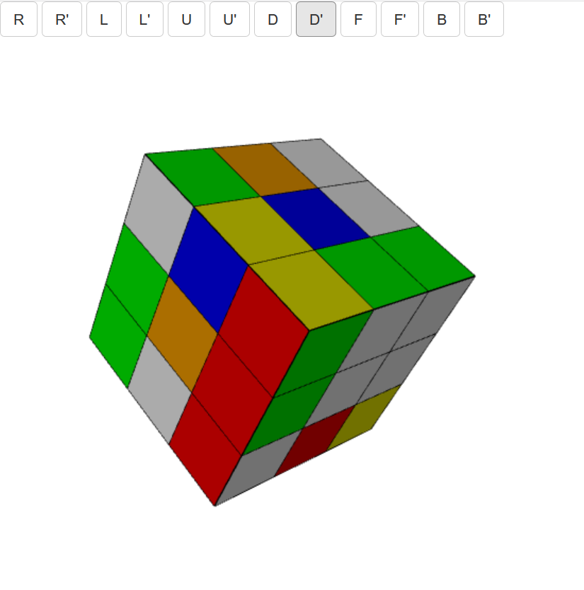
Results
App1:
Rotate Rubik’s cube by clicking the bottoms
App2:
Rotate Rubik’s cube by inputting the formula
https://katasuke.shinyapps.io/rubiks_cube/
https://katasuke.shinyapps.io/rubiks_cube2/

Slide 4
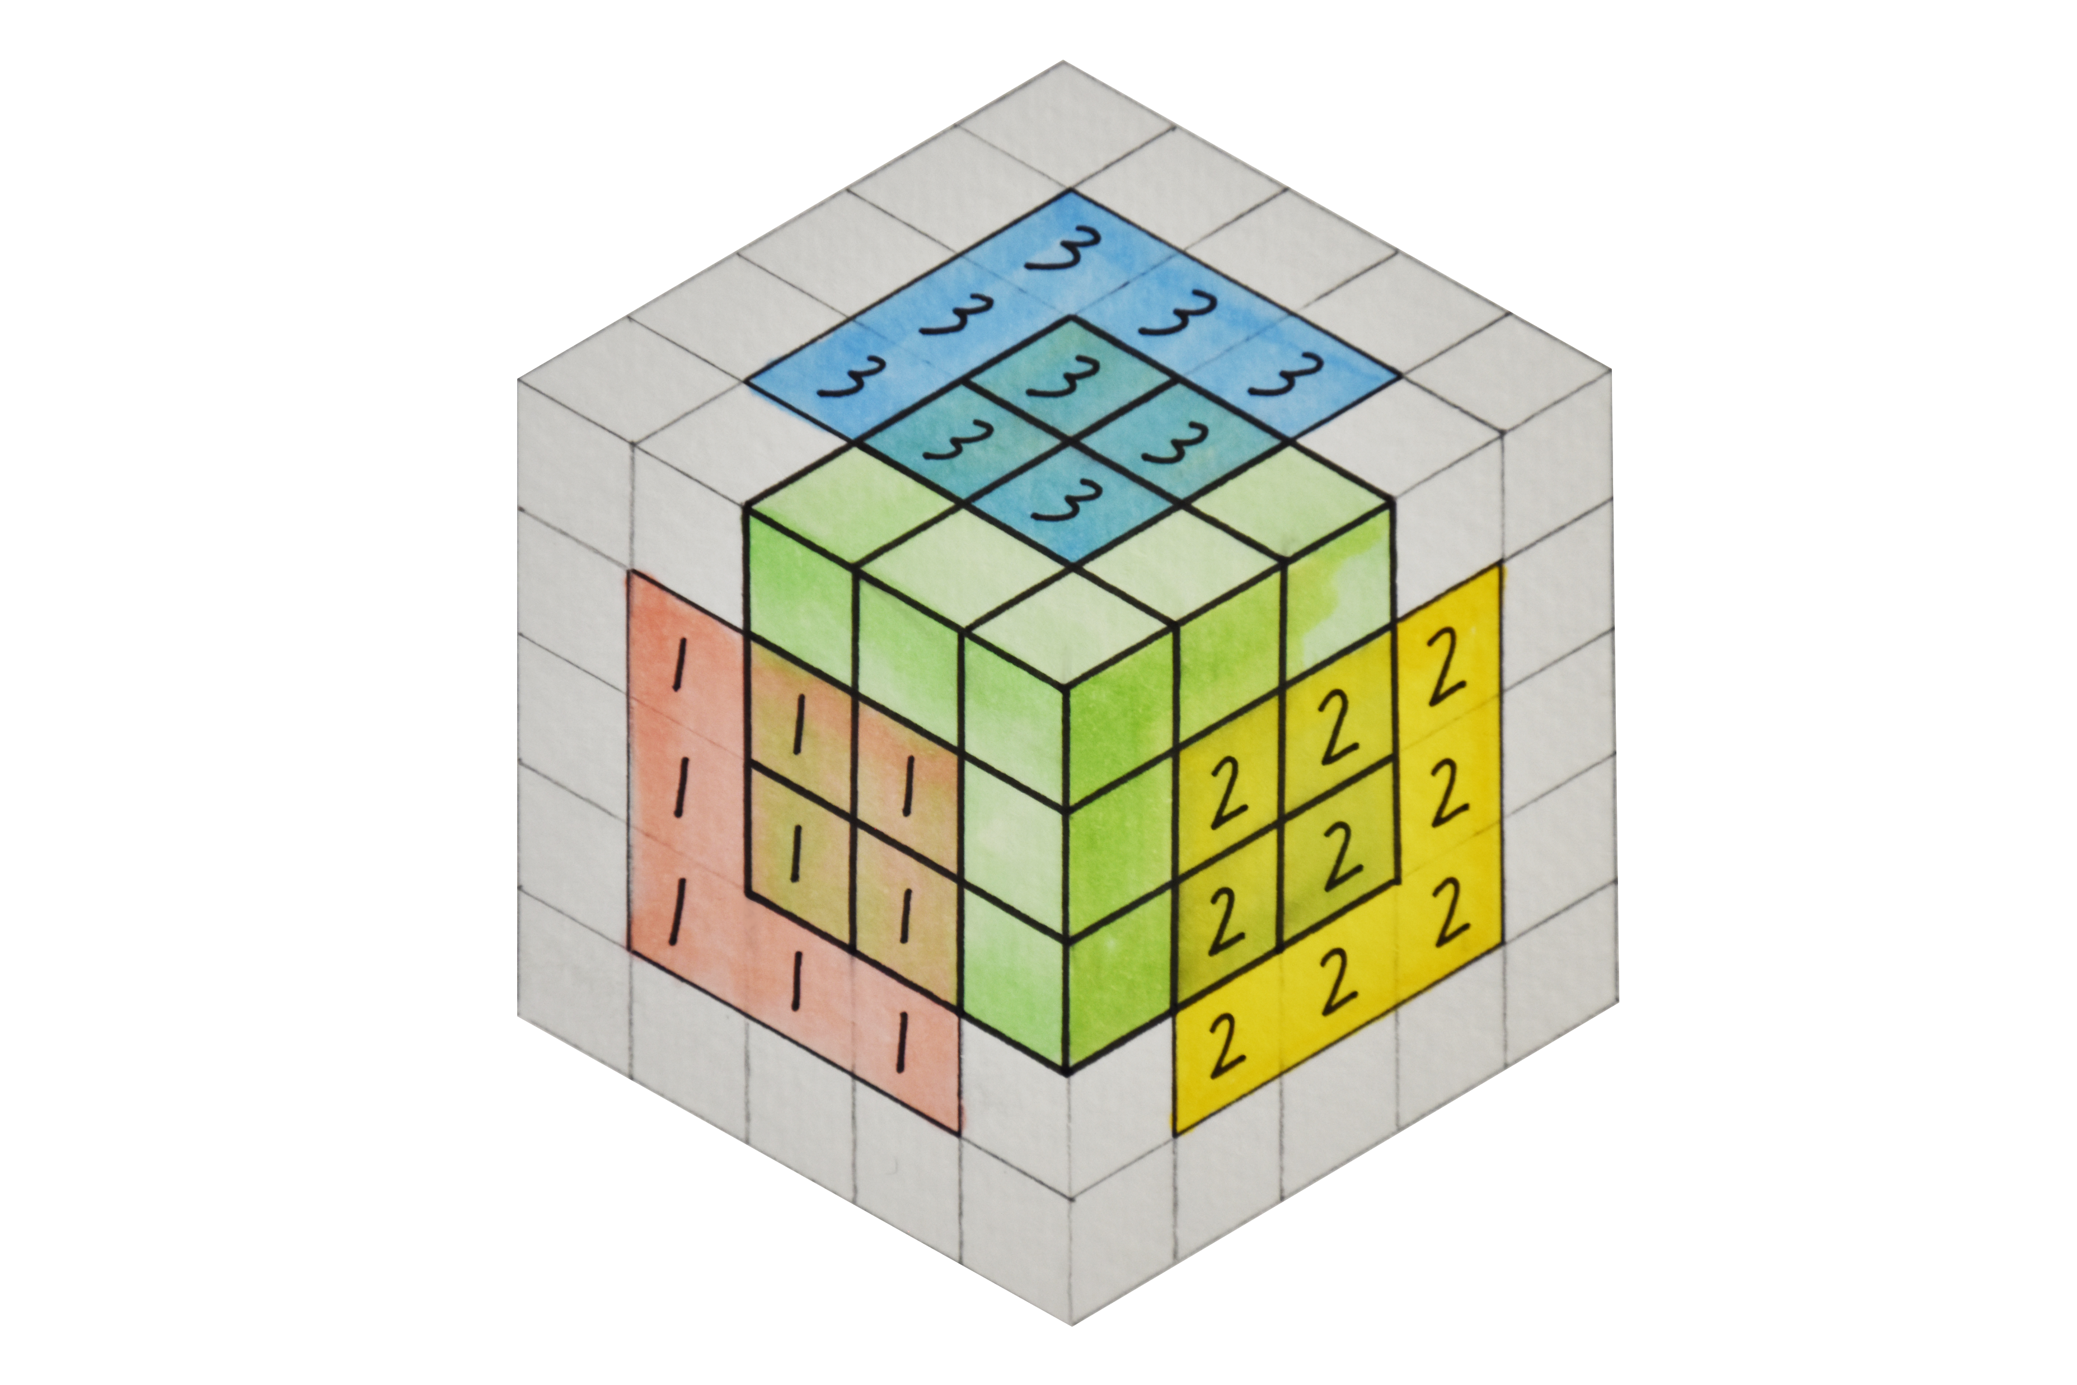
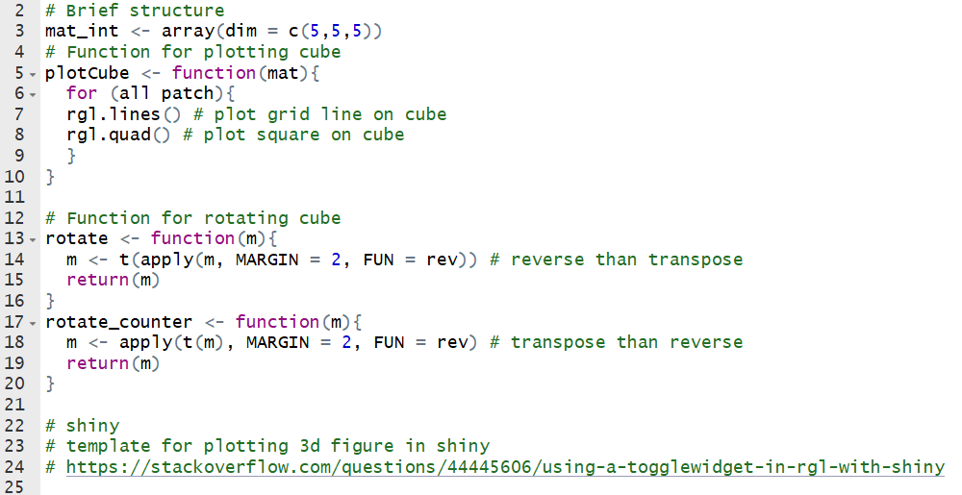
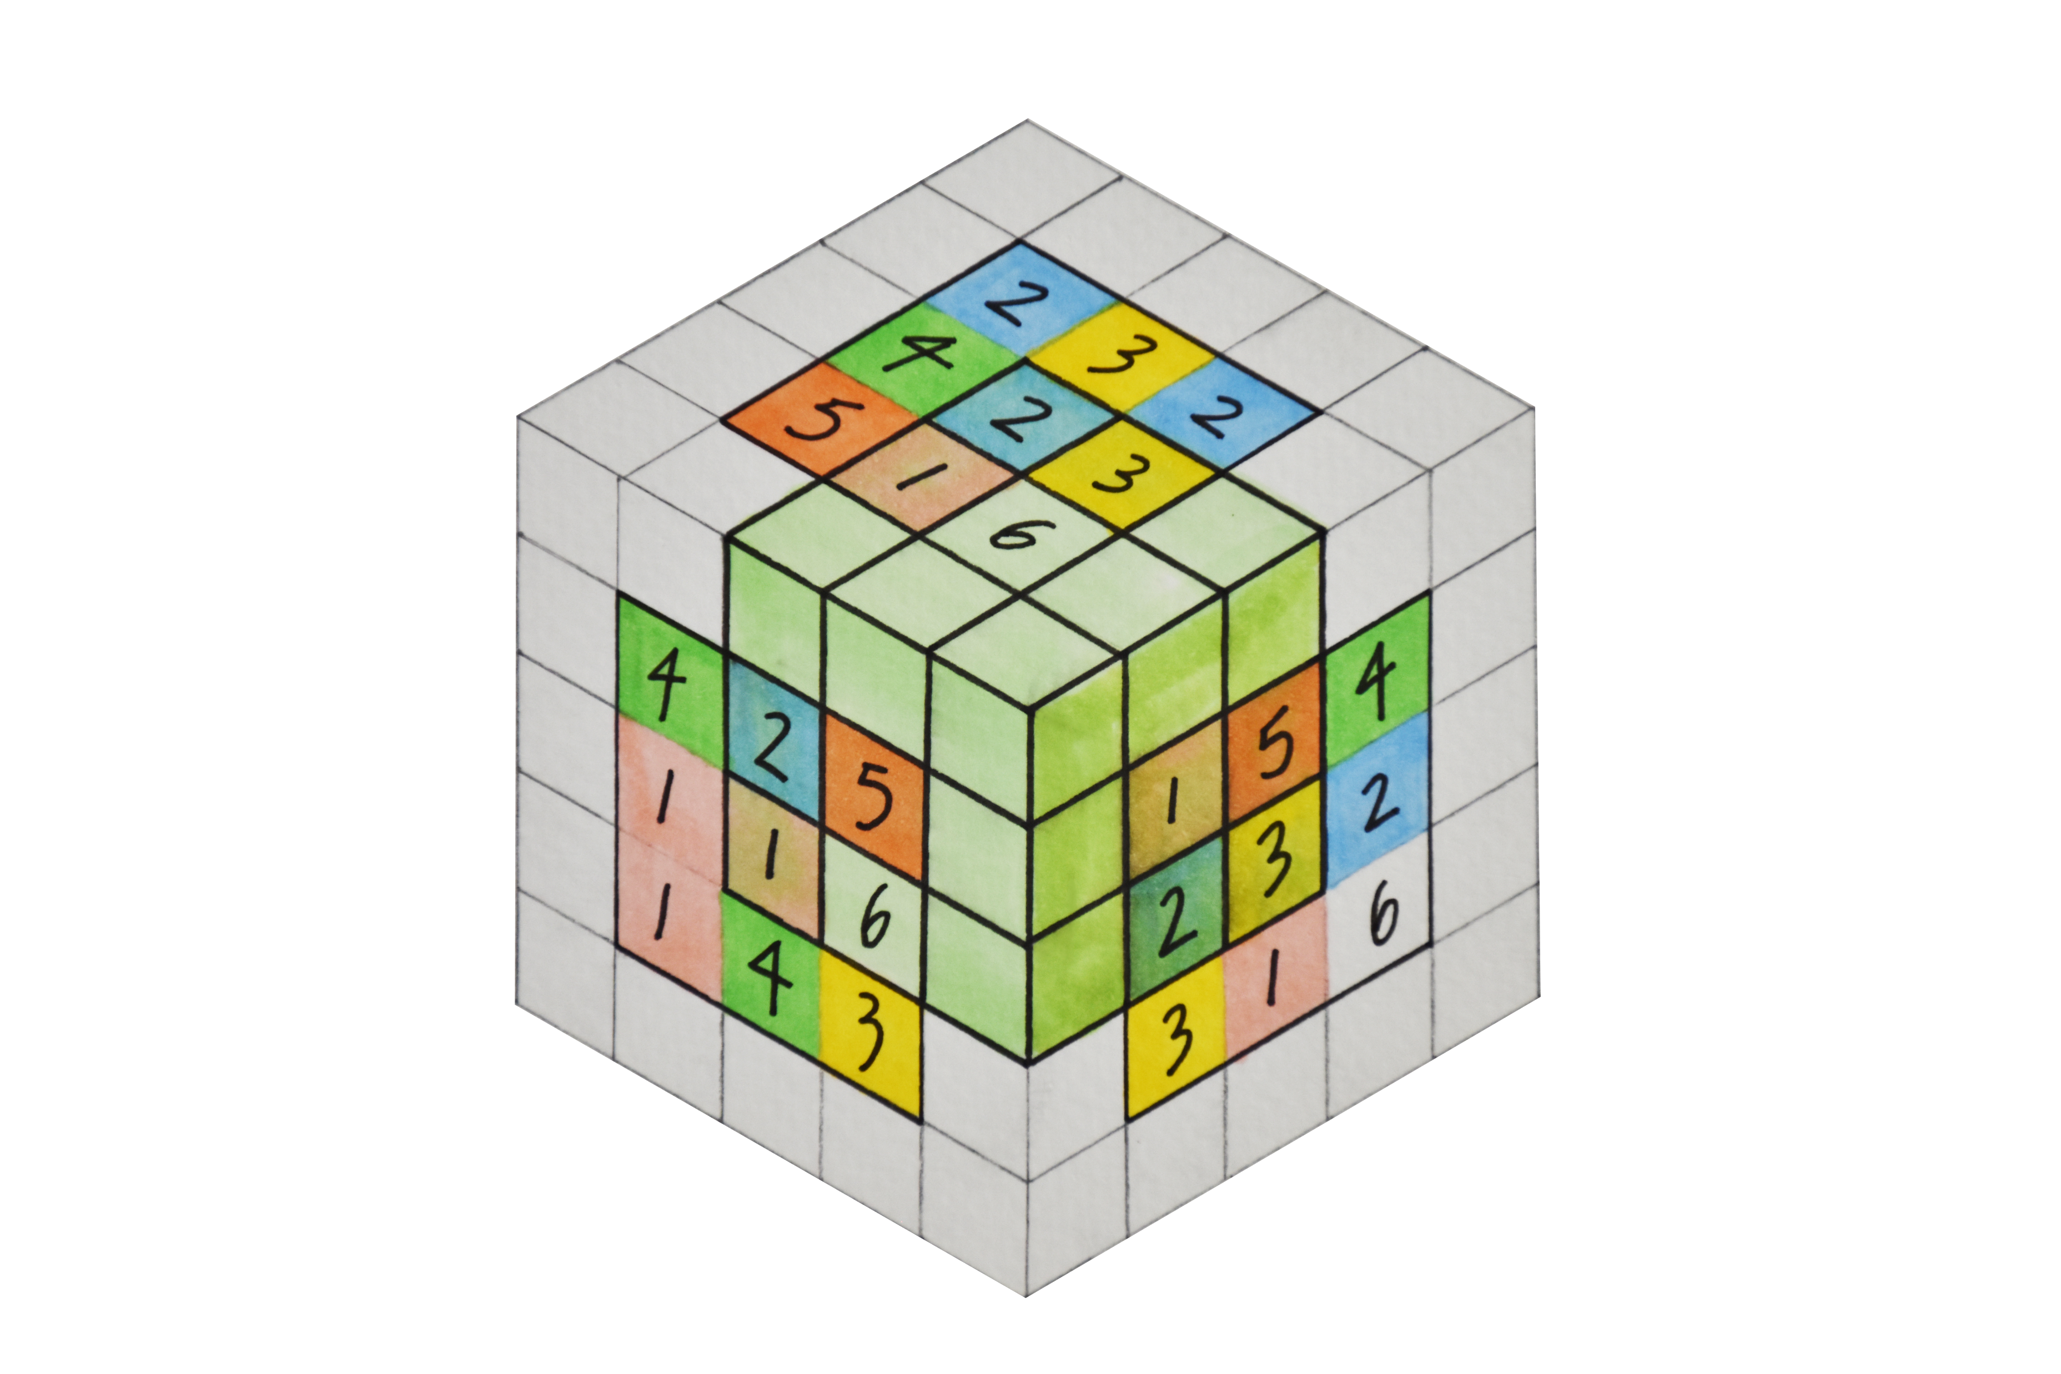
R script structure
Rotation
Figure Credit: Shih-wei Huang

